Slide 1


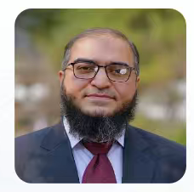


MEMBER
202
6
Zeashan Hameed Khan
  MEMBER ID:
  MEMBER SINCE:
  Section
  2023/9/13
  2025/01/01
  Asia_R01
  AUTHORIZED SIGNATURE
  https://rarl-lab.com
Robotics & Automation Research Lab (RARL), Queens Building, Leicester, LE1 9BH, United Kingdom

Slide 2
MEMBER
202
6
  MEMBER ID:
  MEMBER SINCE:
  Section
  AUTHORIZED SIGNATURE
  https://rarl-lab.com
Robotics & Automation Research Lab (RARL), Queens Building, Leicester, LE1 9BH, United Kingdom

Slide 3
MEMBER
202
6
  MEMBER ID:
  MEMBER SINCE:
  Section
  AUTHORIZED SIGNATURE
  https://rarl-lab.com
Robotics & Automation Research Lab (RARL), Queens Building, Leicester, LE1 9BH, United Kingdom

Slide 4

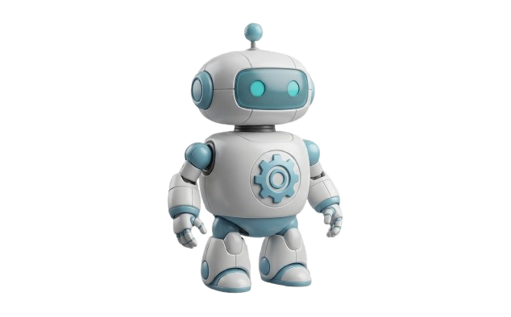

CER
Robotics & Automation Research Lab (RARL)
CERTIFICATE OF MEMBERSHIP
This is to certify that, Mr. ATANU SHUVAM ROY Has been duly elected as a
STUDENT MEMBER
In good standing with the Robotic And Automation Research Laboratory (RARL)
From June 25, 2023
This membership acknowledges commitment to the advancement of intelligent robotic systems and adherence to laboratory's principles and code of conduct.
  Ata Jahangir Moshayedi
  2026 RARL President
  S. Ali Eftekhari
  2026 Asia Section Chair
Verify membership
  https://rarl-lab.com
Robotics & Automation Research Lab (RARL), Queens Building, Leicester, LE1 9BH, United Kingdom

Slide 5
CER
Robotics & Automation Research Lab (RARL)
CERTIFICATE OF MEMBERSHIP
  Ata Jahangir Moshayedi
  2026 RARL President
  S. Ali Eftekhari
  2026 Asia Section Chair
Verify membership
  https://rarl-lab.com
Robotics & Automation Research Lab (RARL), Queens Building, Leicester, LE1 9BH, United Kingdom

